Slide 1
Reflecting objects
Transformations

Slide 2
how to use Oak lessons

Slide 3
I can reflect objects using a range of lines of reflection.

Slide 4
The line of reflection is the fixed line about which an object is reflected. The object and image are equidistant from the line of reflection.

Slide 5

Reflecting objects
Using tracing paper to reflect objects
Counting squares to reflect objects
Counting squares to reflect objects diagonally

Slide 6
Using tracing paper to reflect objects
For this lesson, it is important to have tracing paper and a pencil.
The tracing paper will be used to trace over:
the line of reflection
the object

Slide 7
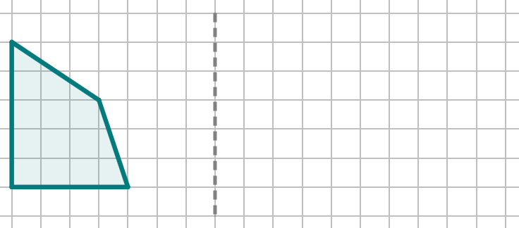
Using tracing paper to reflect objects
Task
Reflect this shape in the line of reflection using tracing paper.
Instructions
Fix the location of your line of reflection by placing a × somewhere on the line.

Slide 8
Using tracing paper to reflect objects
Instructions
Place your tracing paper over the object.
Trace over the:
object
the line of reflection
the extra extra × that fixes your line of reflection

Slide 9
Using tracing paper to reflect objects
Instructions
Flip your tracing paper over in the direction of the reflection.
In this example, this is a horizontal reflection, so the tracing paper is flipped horizontally.

Slide 10
Using tracing paper to reflect objects
Instructions
Line up the line of reflection on the tracing paper with the line of reflection on the diagram.

Slide 11
Using tracing paper to reflect objects
Instructions
Without the × to fix the location of the line of reflection, it would be unclear how far up or down the we need to place the tracing paper.
Line up the × on the tracing paper with the × on the diagram.

Slide 12
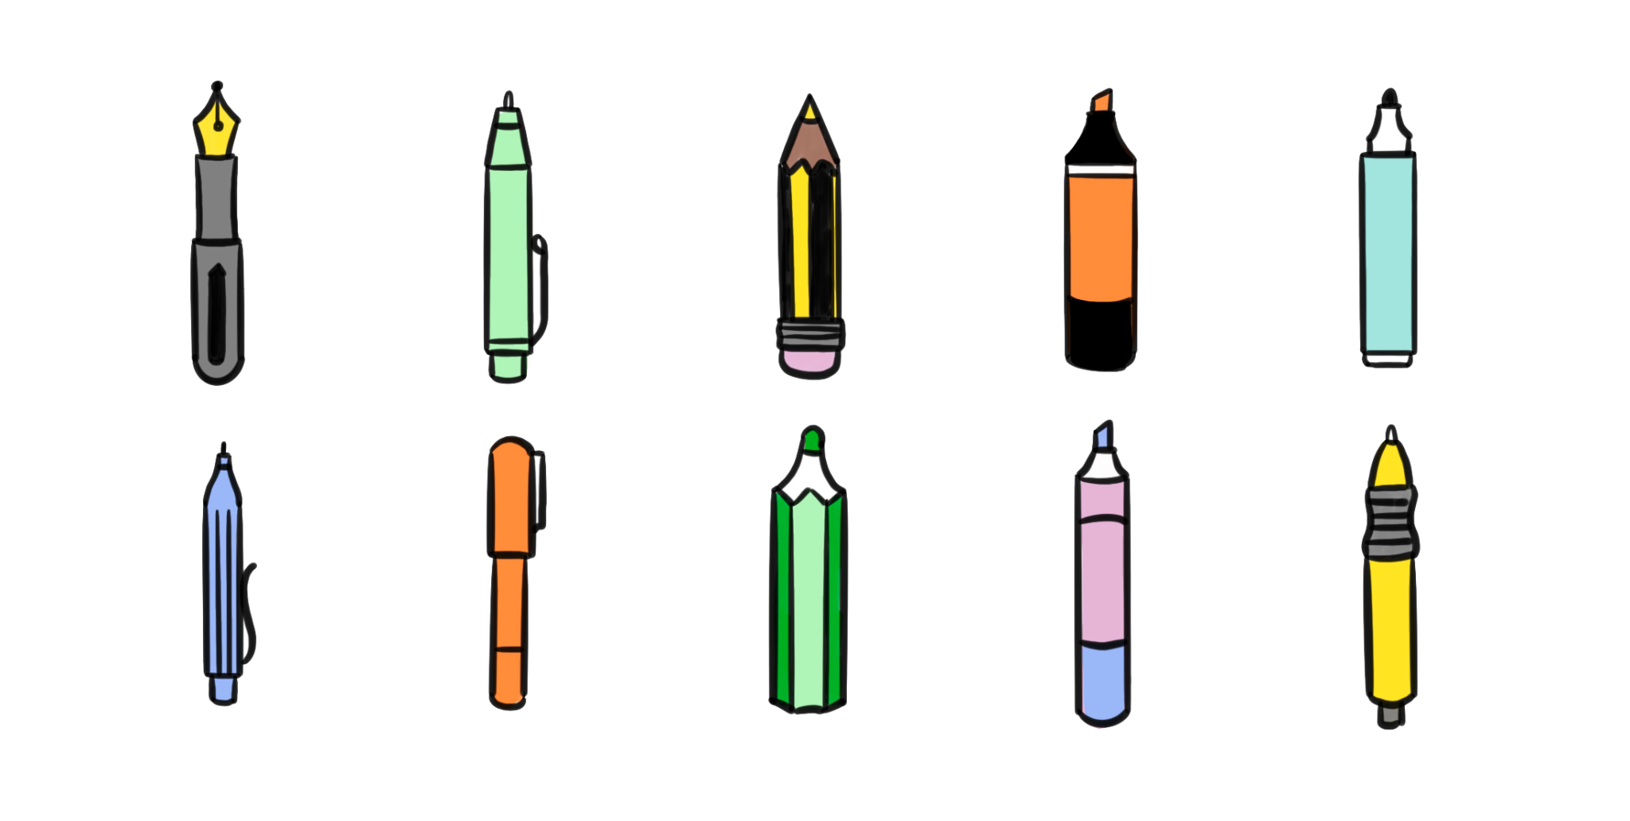
Using tracing paper to reflect objects
Instructions
With your pencil, push firmly onto each vertex of the image on your tracing paper to imprint the vertices onto the diagram.

Slide 13
Using tracing paper to reflect objects
Instructions
Remove the tracing paper.
Connect the imprints of the vertices with a ruler to draw the reflected image.

Slide 14

Using tracing paper to reflect objects
What three things do you need to draw on the tracing paper?
the object
the line of reflection
the × that fixes the line of reflection

Slide 15
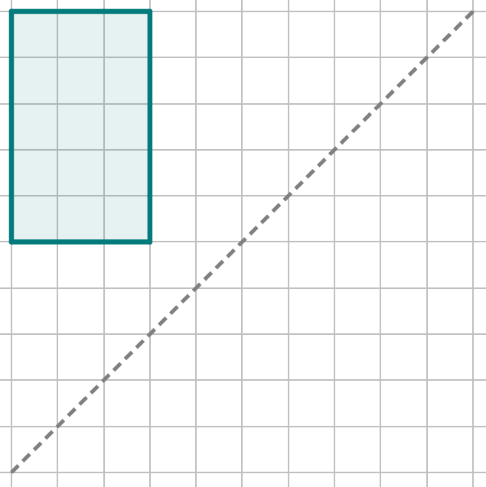
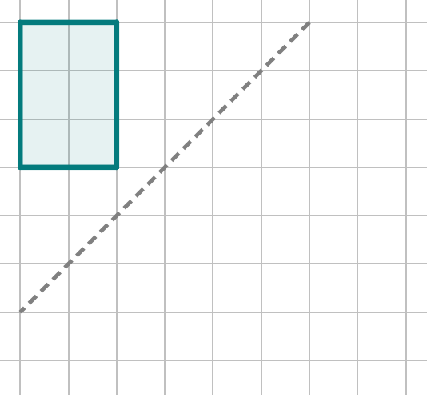
Using tracing paper to reflect objects
Demonstration
You do
Plot a × on the line of reflection.
Put tracing paper over the object and trace over the object, line of reflection, and ×.

Slide 16
Using tracing paper to reflect objects
Demonstration
You do
Flip the tracing paper.
Line up the line of reflection and ×.

Slide 17
Using tracing paper to reflect objects
Demonstration
You do
Push hard with your pencil onto each vertex of the image on the tracing paper.

Slide 18
Using tracing paper to reflect objects
Demonstration
You do
Remove the tracing paper and draw the reflected image onto the diagram.
Your reflected image should be a rectangle that has a base of 3 squares and a height of 2 squares.

Slide 19
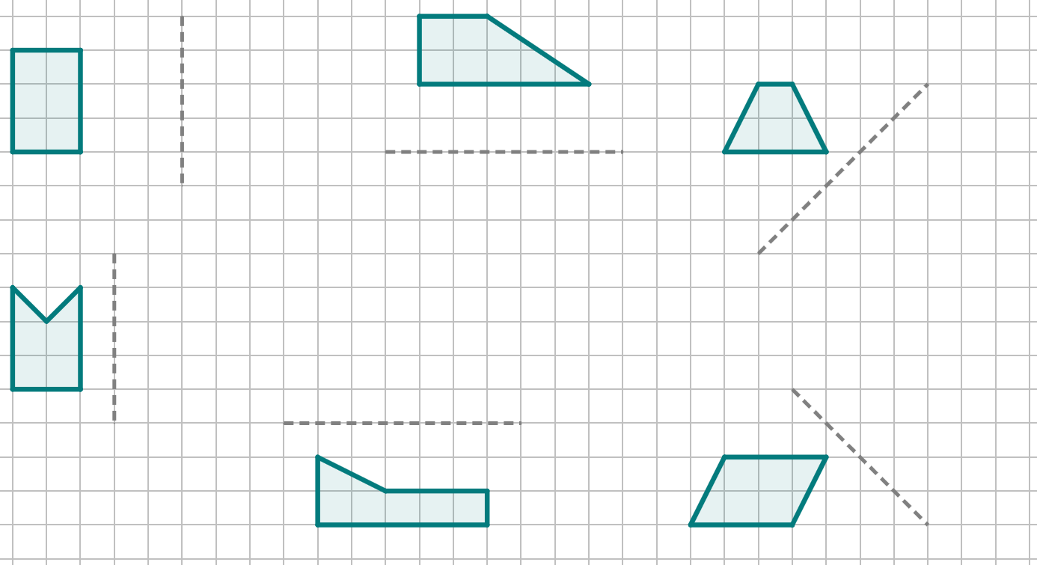
Using tracing paper to reflect objects
1) Reflect each of these objects in the line of reflection closest to it. You must use tracing paper.

Slide 20
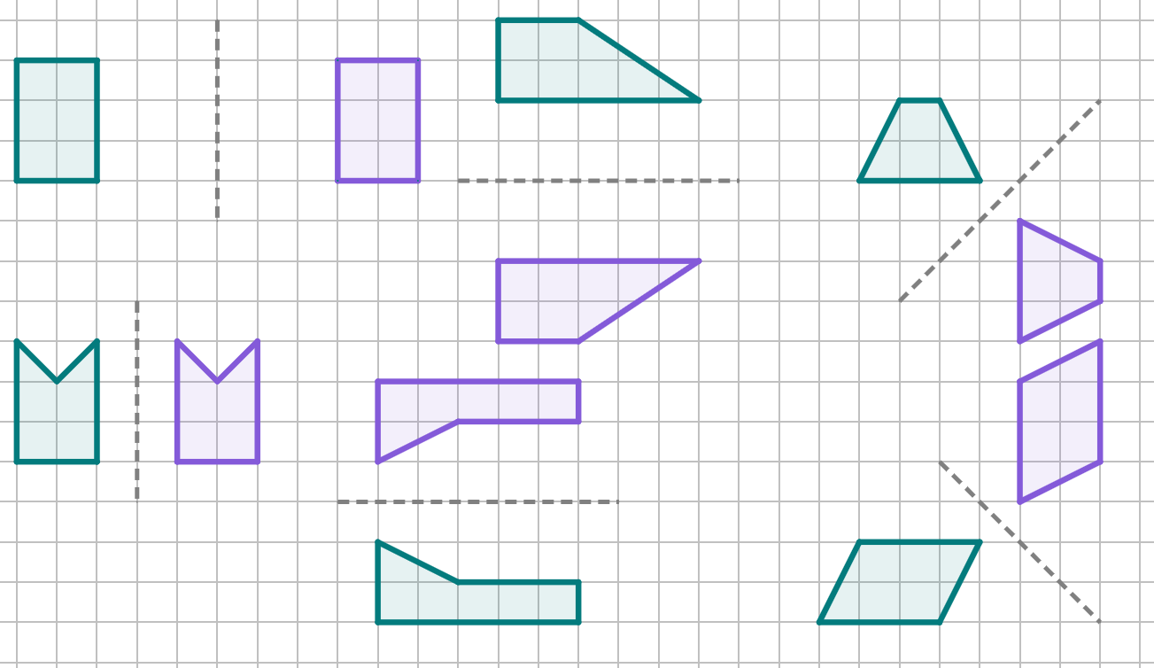
Using tracing paper to reflect objects
1) Reflect each of these objects in the line of reflection closest to it. You must use tracing paper.

Slide 21
Reflecting objects
Using tracing paper to reflect objects
Counting squares to reflect objects
Counting squares to reflect objects diagonally

Slide 22
Counting squares to reflect objects
Reflecting using tracing paper is always helpful, as you can perform any reflection, regardless of complexity.
But it can be time consuming and unnecessary if you can visualise the reflection.
The method of reflection by counting squares uses the property of reflection that a point on an object and its corresponding point on the image are equidistant from the line of reflection.

Slide 23
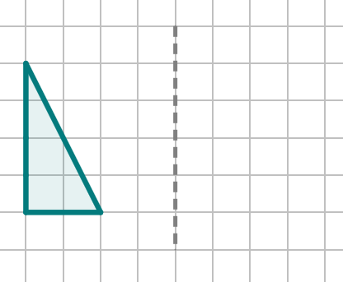
Counting squares to reflect objects
Reflect this object in the line of reflection by counting squares.
Choose a vertex of the object.
With your pencil, count the number of squares you travel to get to the line of reflection.
Repeat that number of squares again on the opposite side of the line of reflection.
2 squares
2 squares

Slide 24
Counting squares to reflect objects
Reflect this object in the line of reflection by counting squares.
Choose a vertex of the object.
With your pencil, count the number of squares you travel to get to the line of reflection.
Repeat that number of squares again on the opposite side of the line of reflection.
Repeat this process for each vertex of the shape.
4 squares
4 squares

Slide 25
Counting squares to reflect objects
Reflect this object in the line of reflection by counting squares.
Choose a vertex of the object.
4 squares
4 squares
With your pencil, count the number of squares you travel to get to the line of reflection.
Repeat that number of squares again on the opposite side of the line of reflection.
Repeat this process for each vertex of the shape.

Slide 26

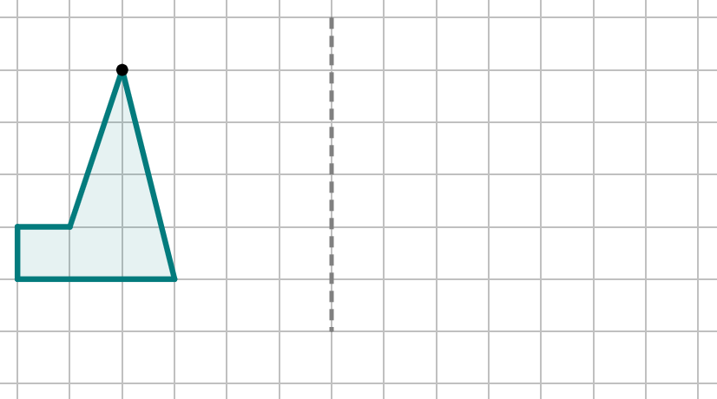

Counting squares to reflect objects
Which of these is the location of vertex A after it has been reflected?
A
a
b
c
d

Slide 27
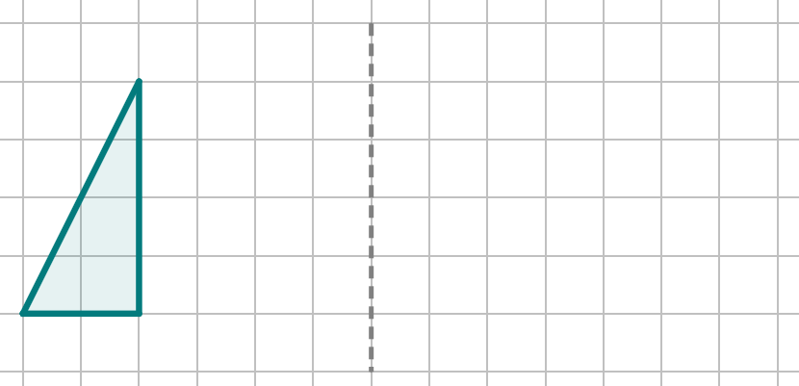
Counting squares to reflect objects
If the shape isn’t very complex, you may be able to plot one vertex of the reflection, and then draw the rest of the reflection without needing to count the squares.
This is optional, and you can always count the squares for each vertex.

Slide 28
Counting squares to reflect objects
Choose one vertex.
Count the squares to the line of reflection and repeat that number onto the other side of the line of reflection.
On this example, I see the base of the object goes left from my chosen vertex, so in the image, the base will go right.
4 squares
4 squares
From my chosen vertex, the top of the object will be the same height as the top of the image.

Slide 29
Counting squares to reflect objects
Choose one vertex.
Count the squares to the line of reflection and repeat that number onto the other side of the line of reflection.
On this example, I see the base of the object goes left from my chosen vertex, so in the image, the base will go right.
2 squares
2 squares

Slide 30
Counting squares to reflect objects
From my chosen vertex, the top of the object will be the same height as the top of the image.
4 squares
4 squares

Slide 31
Counting squares to reflect objects
From my chosen vertex, the top of the object will be the same height as the top of the image.

Slide 32
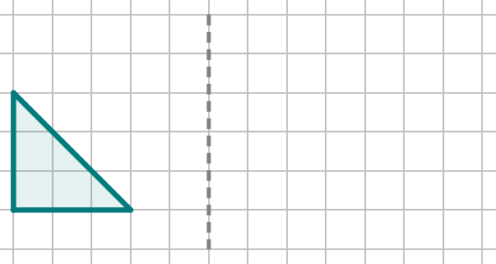
Counting squares to reflect objects
I have counted squares to reflect vertex A correctly. The reflected image is labelled A′.
Which diagram shows the correct reflection of the base of the shape?
a
b
A
A′
A
A′

Slide 33
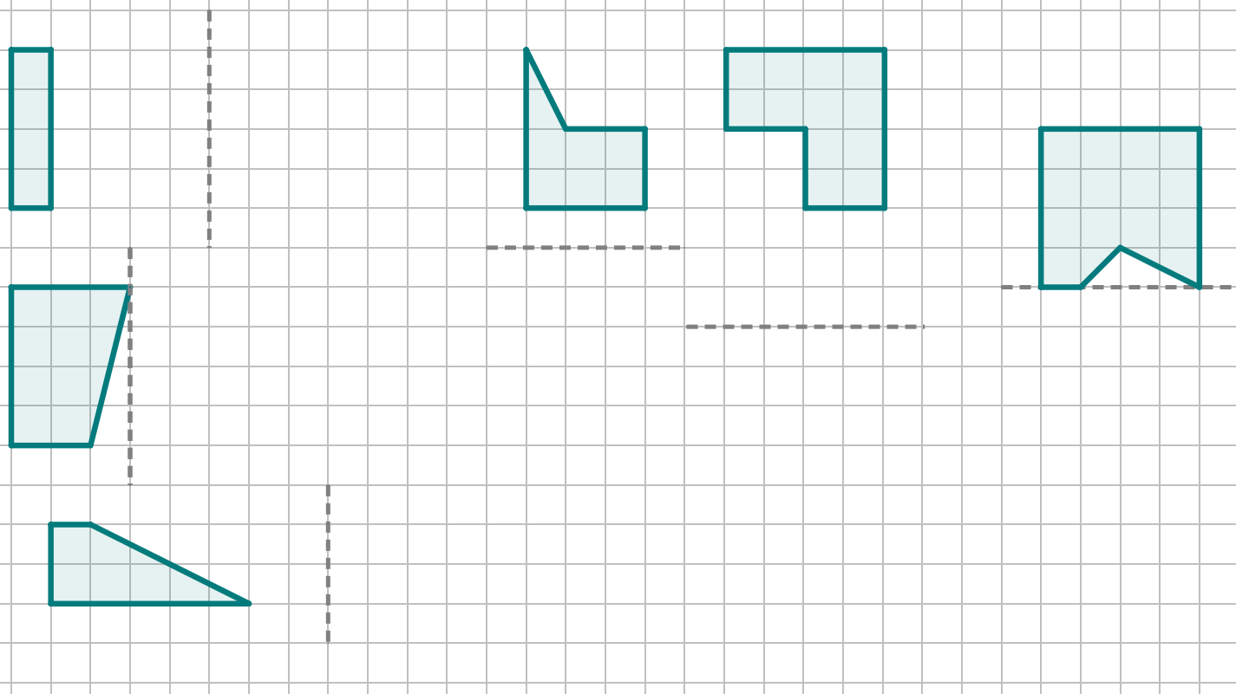
Counting squares to reflect objects
1) Reflect each of these objects in the line of reflection closest to it. Do not use tracing paper.

Slide 34
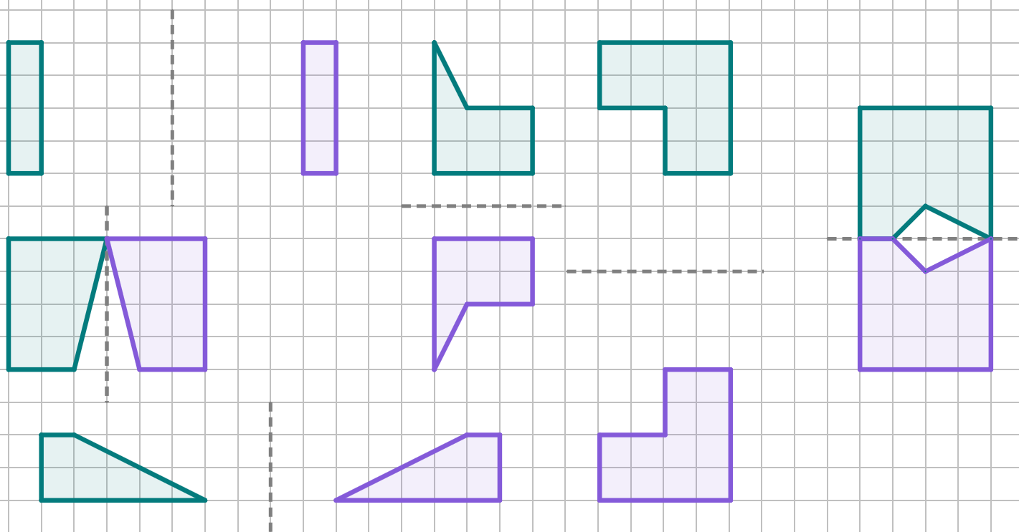
Counting squares to reflect objects
1) Reflect each of these objects in the line of reflection closest to it. Do not use tracing paper.

Slide 35
Reflecting objects
Using tracing paper to reflect objects
Counting squares to reflect objects
Counting squares to reflect objects diagonally

Slide 36
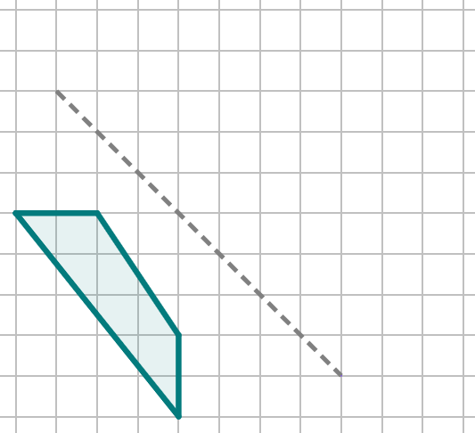
Counting squares to reflect objects diagonally
It is advised you count the squares for all vertices when doing a diagonal reflection.
This vertex is one full diagonal square from the line of reflection.
Replicate this one full square diagonal on the other side of the line of reflection.

Slide 37
Counting squares to reflect objects diagonally
It is advised you count the squares for all vertices when doing a diagonal reflection.
Whereas this vertex is one and a half diagonal squares from the line of reflection.
When you replicate this distance on the other side of the line of reflection, start by counting the half diagonal square first, before going the full squares.
1 diagonal
+ extra half a diagonal

Slide 38
Counting squares to reflect objects diagonally
It is advised you count the squares for all vertices when doing a diagonal reflection.
Complete the method for all vertices.
Remember to replicate the half-diagonal first!

Slide 39
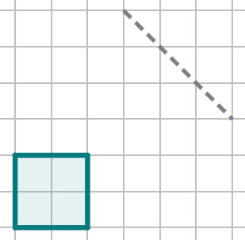
Counting squares to reflect objects
How many diagonal squares are there between vertex A and the line of reflection?
a
1 and a half diagonal squares
b
2 diagonal squares
2 and a half diagonal squares
A
c
d
3 and a half diagonal squares

Slide 40
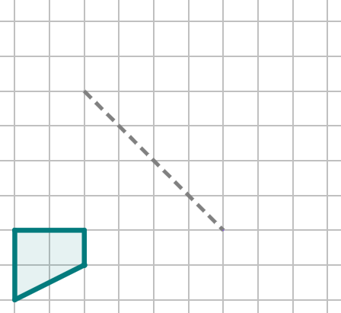
Counting squares to reflect objects
Which of these is the correct location of the reflected image of vertex A?
a
b
d
c
A

Slide 41
Counting squares to reflect objects
Which of these is the correct location of the reflected image of vertex B?
b
a
c
d
B

Slide 42
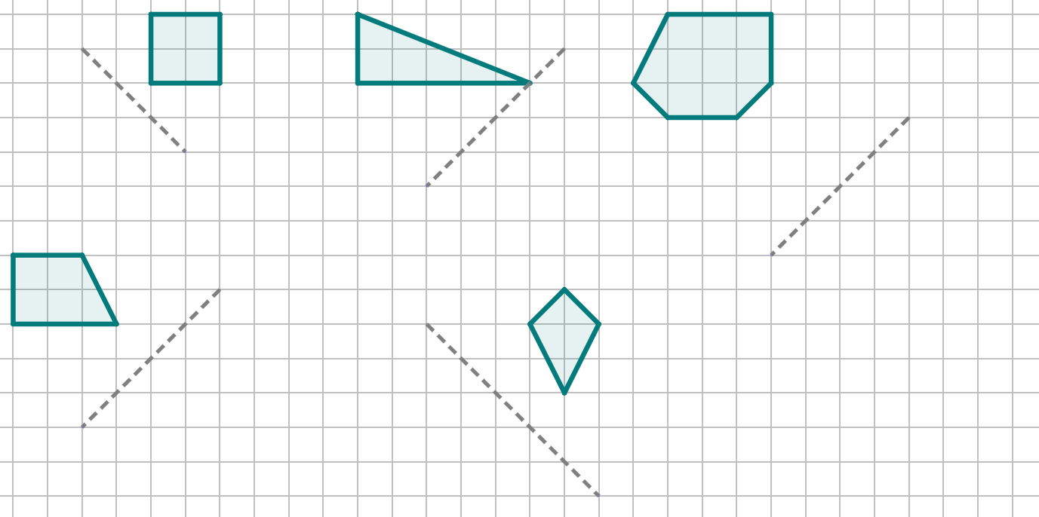
Counting squares to reflect objects diagonally
1) Reflect each of these objects in the line of reflection closest to it. Do not use tracing paper.

Slide 43
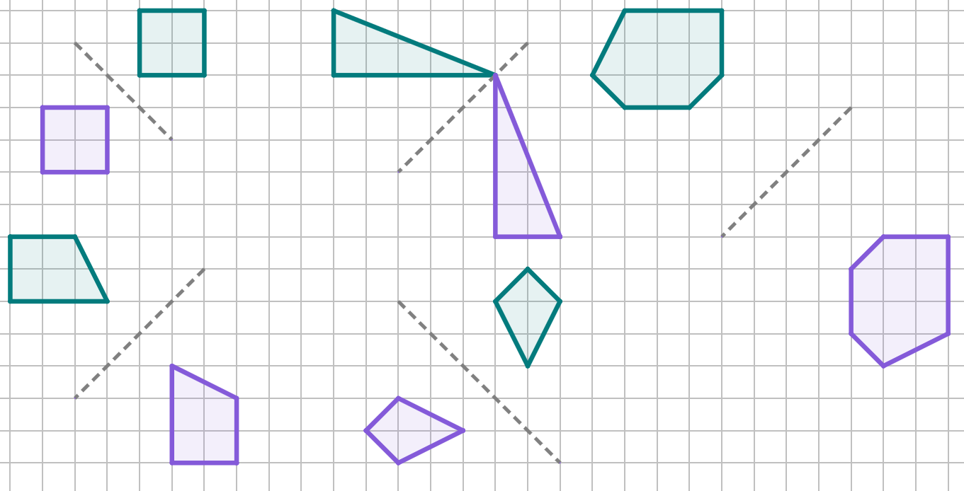
Counting squares to reflect objects diagonally
1) Reflect each of these objects in the line of reflection closest to it. Do not use tracing paper.

Slide 44
Reflecting objects
Tracing paper can be used to help reflect objects.
Counting the number of squares between a vertex on an object and a line of reflection, and then repeating it on the other side of the line of reflection is an effective way of reflecting objects that utilises the property of equidistance between the object and image with the line of reflection.
Reflecting diagonally requires the counting of the diagonals (and half-diagonals) between the vertex of an object and the line of reflection.

Slide 45

© Oak National Academy 2023.
Produced in partnership with Mathematics in Education and Industry.
Licensed on the Open Government Licence v3.0, except where otherwise stated. See Oak terms and conditions.

